Slide 1
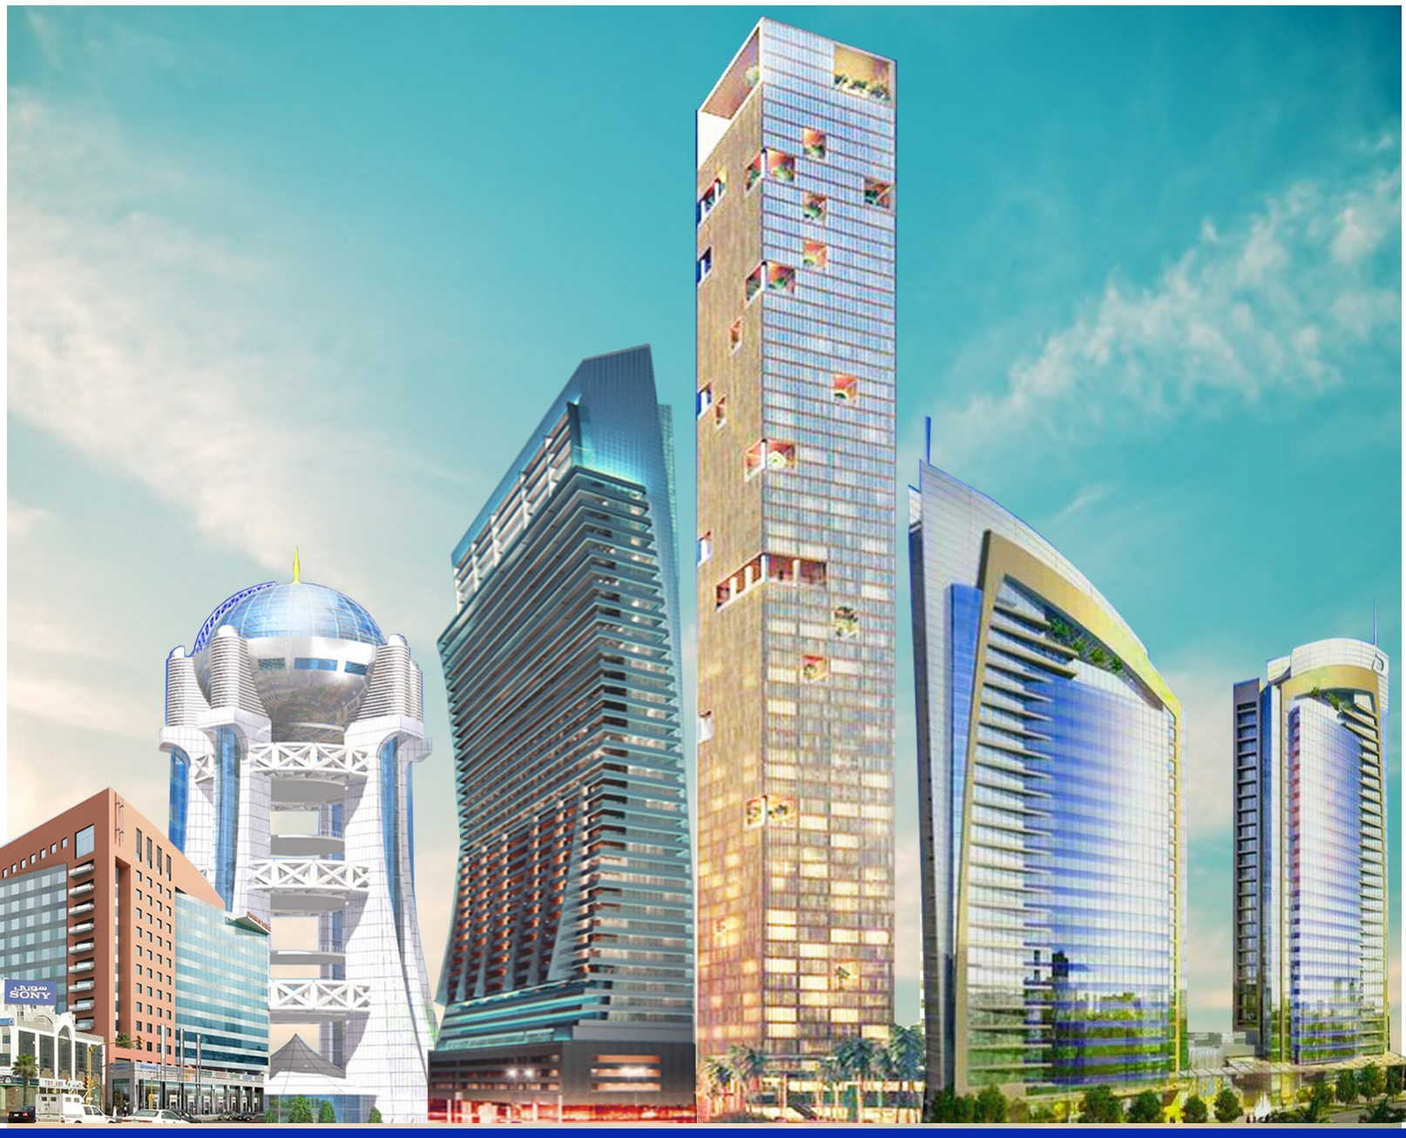
www.amg-metal.com

Slide 2
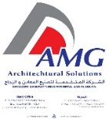
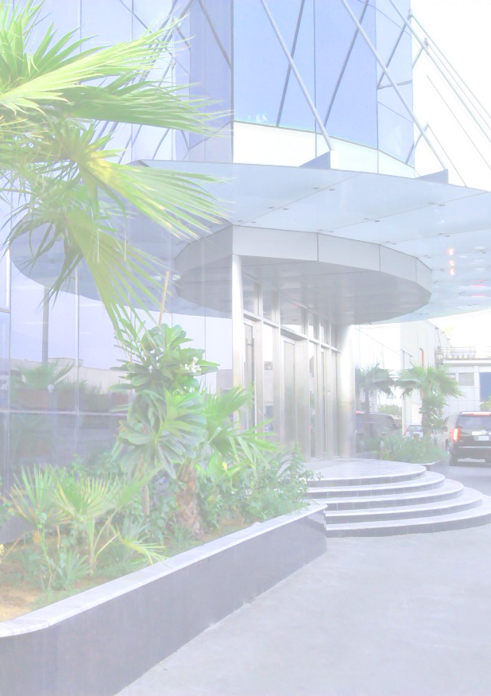
Introduction
We gladly introduce, Advanced Manufacturing for Metal & Glass Co. also known as AMG, with its location in 2nd Industrial Area, Dammam, Saudi Arabia. AMG is wholly owned by US-American; established in the year 2007; with a paid-up capital of 20,000,000 Saudi Riyals; under License No. (2050058201) from the Ministry of Commerce and Industry.
From its fundamentals, “AMG” has grown to become one of the most outstanding companies in its specialized fields of design, fabrication/manufacturing, and installation of aluminum and glazing products, such as:
Stick & Unitized Curtain Wall System
Doors and Windows
Fixed and Frameless Partitions
Louvers & Sunshades
Aluminum Wall Cladding
Mashrabiya / Decorative Panels
Storefronts
Skylight and Dome
And a lot more.
These and more products of our Top of the Line Equipments and Machineries which we constantly upgrade at par with our skilled, trained and professional manpower resources to ensure that international standards and specifications are met. This would mean that AMG will continue to strive and achieve for excellent quality products and services.
Commercial Registration: 2050058201
Industrial License: 20330215721
Chamber of Commerce: 91312
Industrial License: 20330215721
Chamber of Commerce: 91312

Slide 3
Introduction
“AMG served successfully to the utmost satisfaction of its clients in the following sphere of activities.”
1. Aluminum Fabrication:
From extruded and rolled materials supplied by globally known sophisticated suppliers such as TECHNAL, BALEXCO, ALUPCO, REYNAERS, ALUMAN, EFP, VISTAWALL, ALU-K, GUTMANN, INSTALLUX, and SCHUCO with the following sub-activities;
DESIGN: From concept to full working drawing including technical submissions and supportive data.
FABRICATION: Utilizing the state-of-the-art equipment and classy machines; the fabrication is done into the
highest degree of accuracy and finish.
ASSEMBLY: Using crimping method or other mechanical connections, all units are assembled to
international standards.
INSTALLATION: Trained installers, controlled by Project Manager is working in planned and agreed
sequence, having regard to individual project requirements, covering, securing to masonry,
alignment and application of caulking/mastic sealant.
TRANSPORTATION: AMG has its own fleet to transport the material to the customers throughout the
Kingdom Provinces.

Slide 4
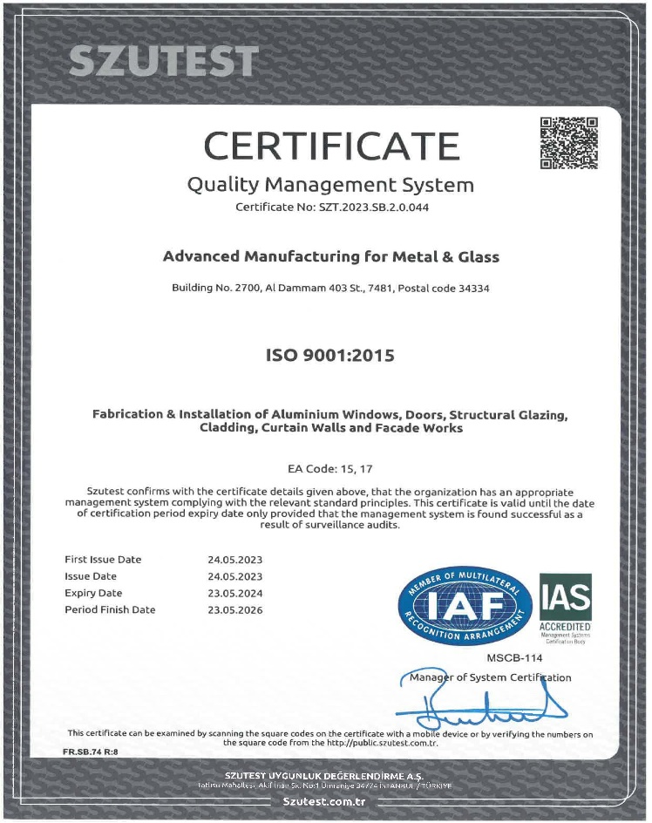
2. Quality
Pre-delivery inspection of materials ensures strict quality control scheme is being implemented to check flaws and errors in materials and workmanship.
Quality Policy:
We at AMG establish, implement, maintain and continually improve Quality Management System according to International Standard aligned with our scope - “Design, Fabrication, Assembly and Installation of Façade Works”.
HSE Policy:
AMG requires the active commitment to and accountability for Health, Safety, & Environment (HSE) from all employees and all contractors. We are committed to protect and strive for improvement of the health, safety, and security of our people at all times; eliminate quality nonconformances and HSE accidents; meet specified customer requirements and ensure continuous customer satisfaction; set quality and HSE performance objectives; measure results; and assess and continually improve processes, services, and product quality through the use of an effective management system; plan for, respond to, and recover from any emergency, crisis, and business disruption; minimize our impact on the environment through pollution prevention, reduction of natural resource consumption and emissions, and the reduction and recycling of waste; apply our technical skills to all HSE aspects in the design and engineering of our services and products; improve our performance on issues relevant to our stakeholders that are of global concern and on which we can have an impact and share with them our knowledge of successful HSE programs and initiatives.

Slide 5
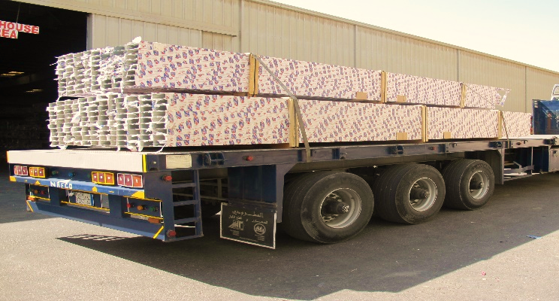
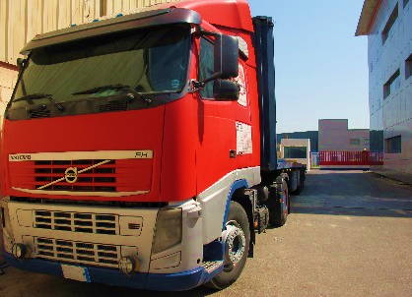
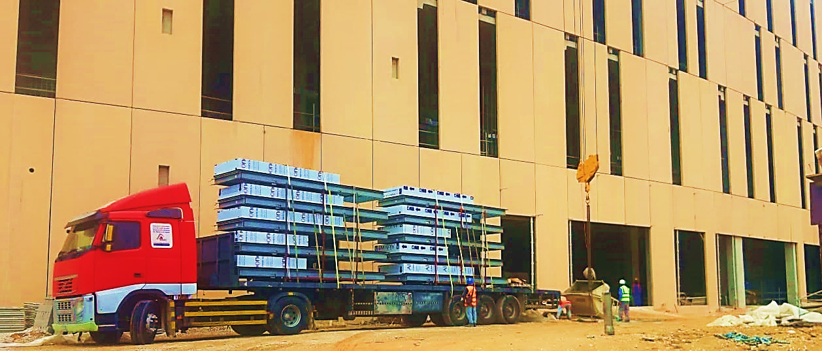
Introduction
3. Delivery:
Inspections of the goods/products are to be conducted to ensure before it is being delivered for installation.
Quality check is cleared, and delivery notes are to be issued to complete the documents before sending it to the site.

Slide 6
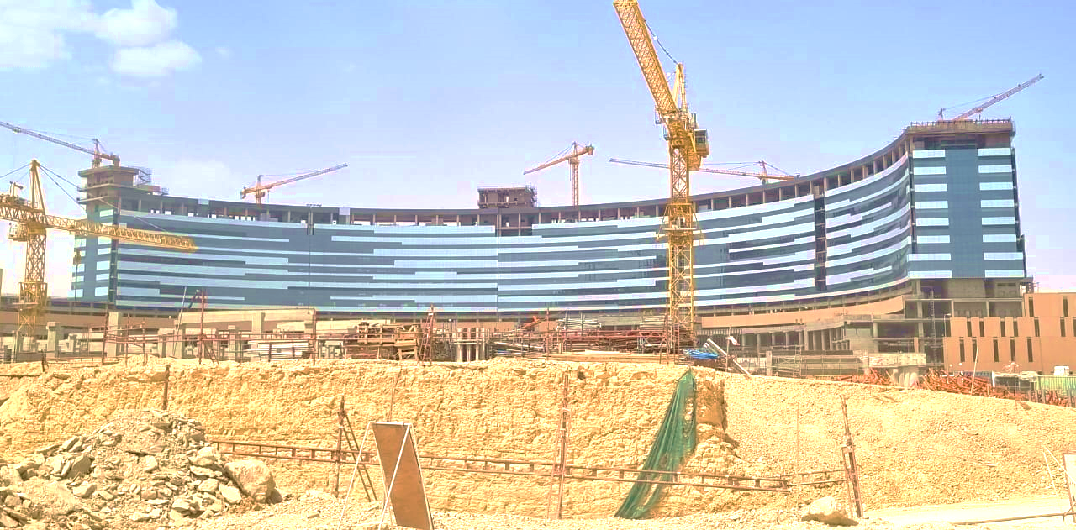
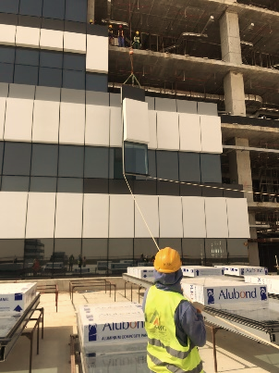
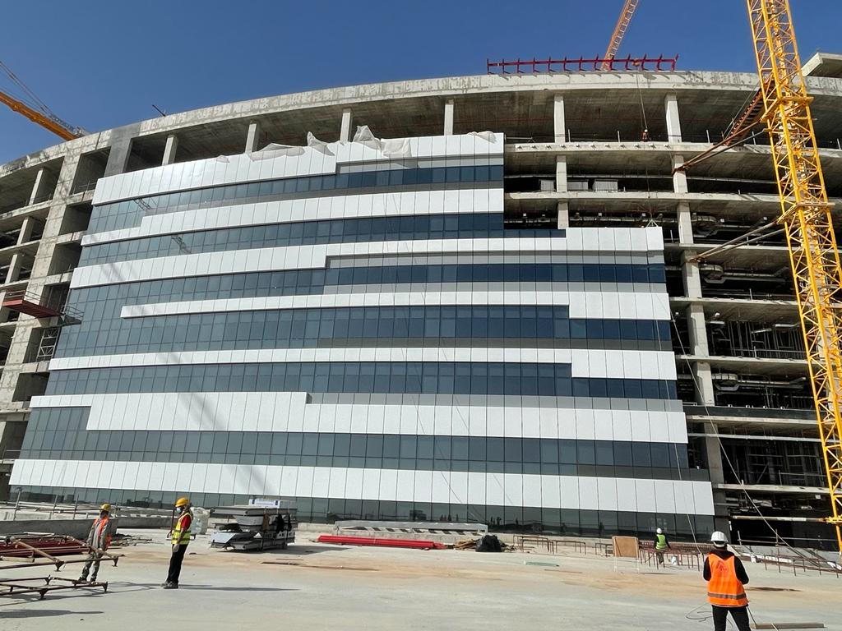
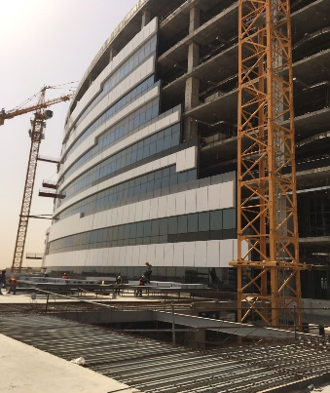
Introduction
4. Installation:
The delivered materials are then to be checked and quality measures are to be executed at the site to further ensure the quality of the product

Slide 7
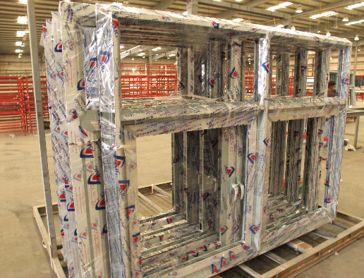
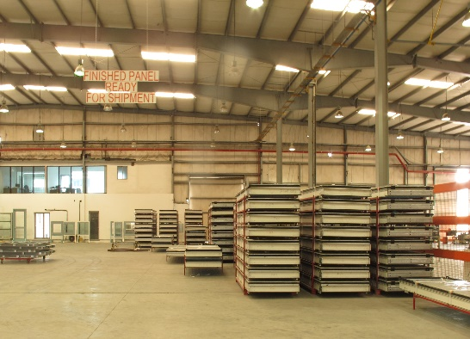
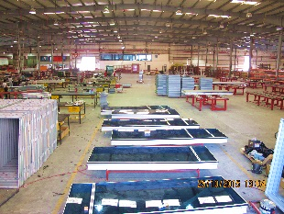
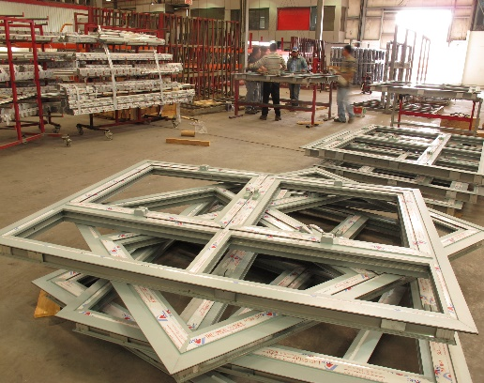
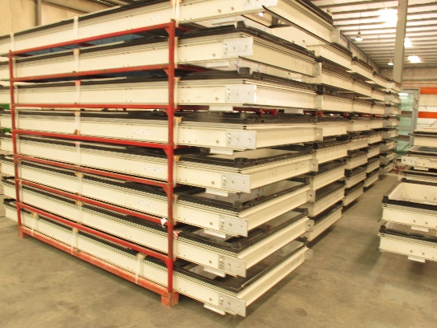
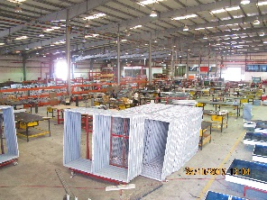
Introduction
Production Capacity:
At present AMG can produce between 800 m² to 1,200 m² of glazed aluminum products, operating in one shift of 8 hours a day. The production range includes doors & windows, louvers & sunshades, fixed & frameless partitions, railings, unitized aluminum glazed curtain wall, stick aluminum glazed curtain wall, skylight and domes, mashrabiya and decorative panels, ACP walls, among others.

Slide 8
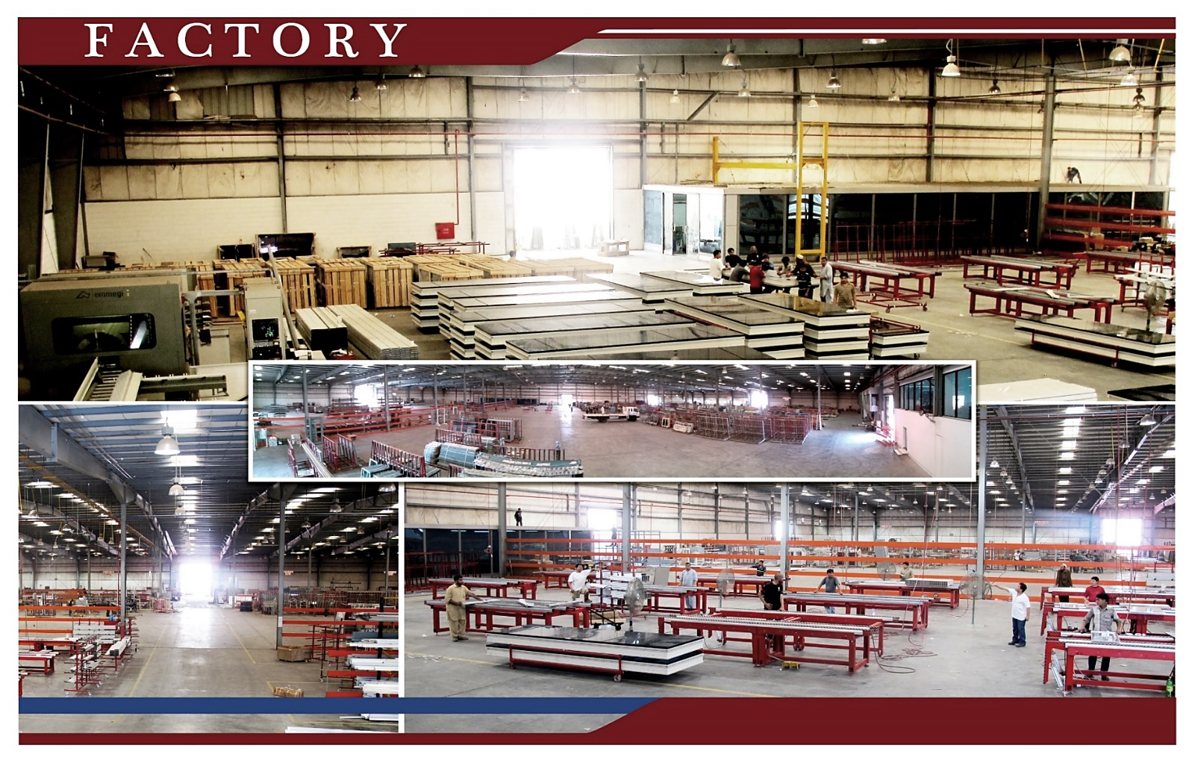
FACILITIES

Slide 9
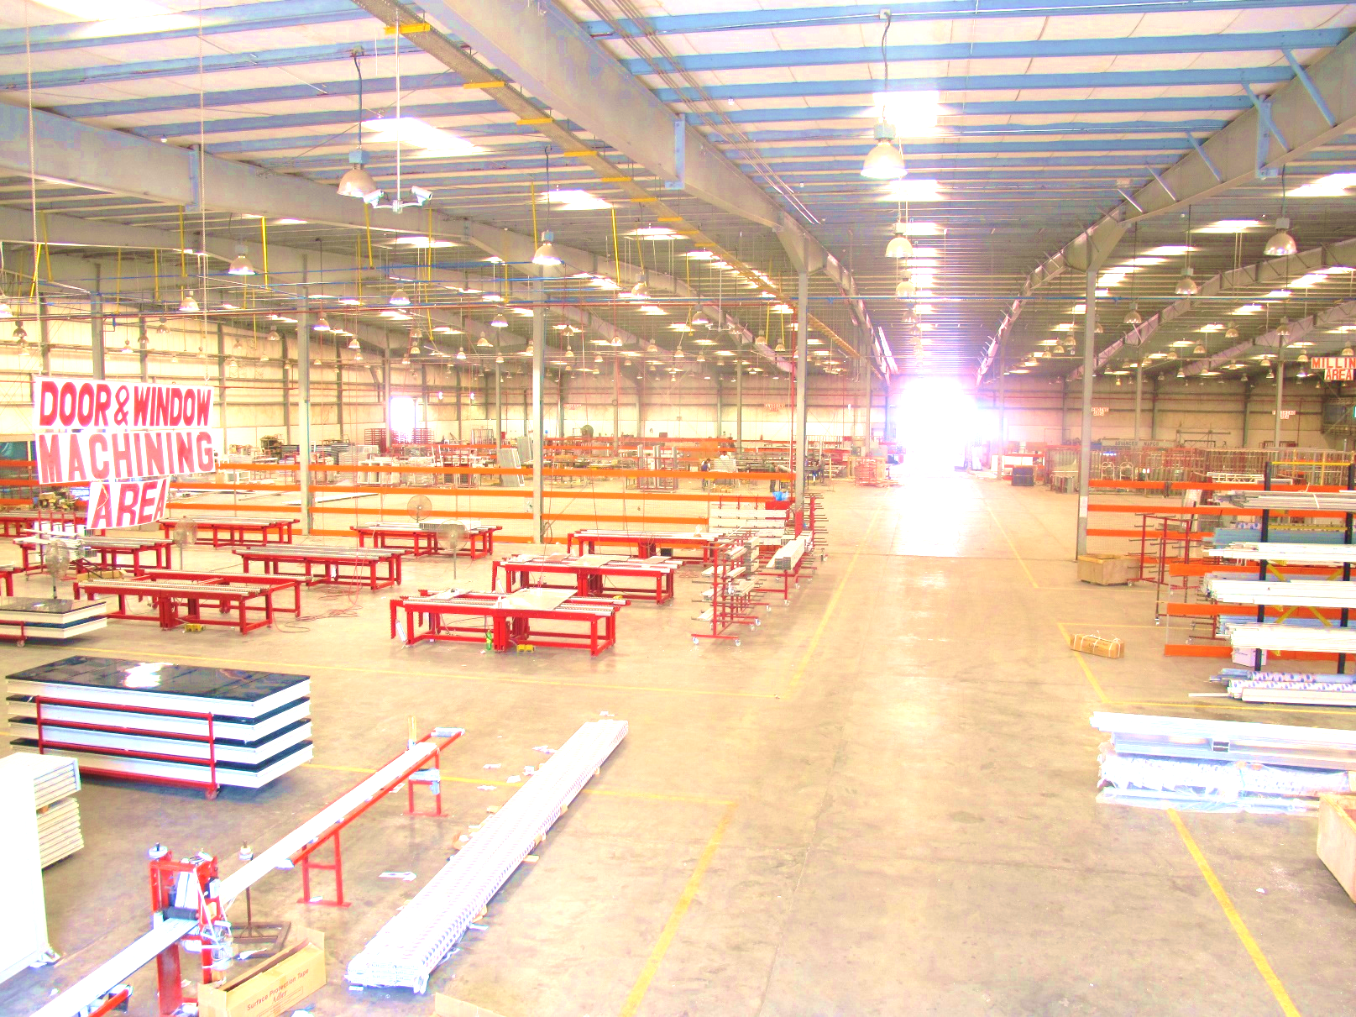
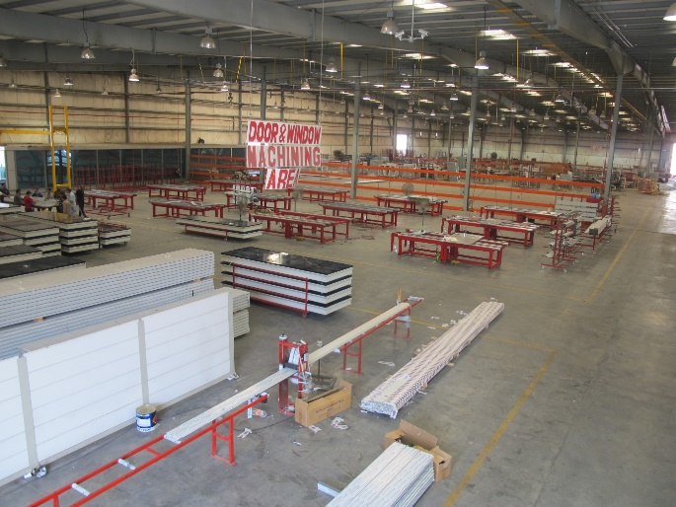
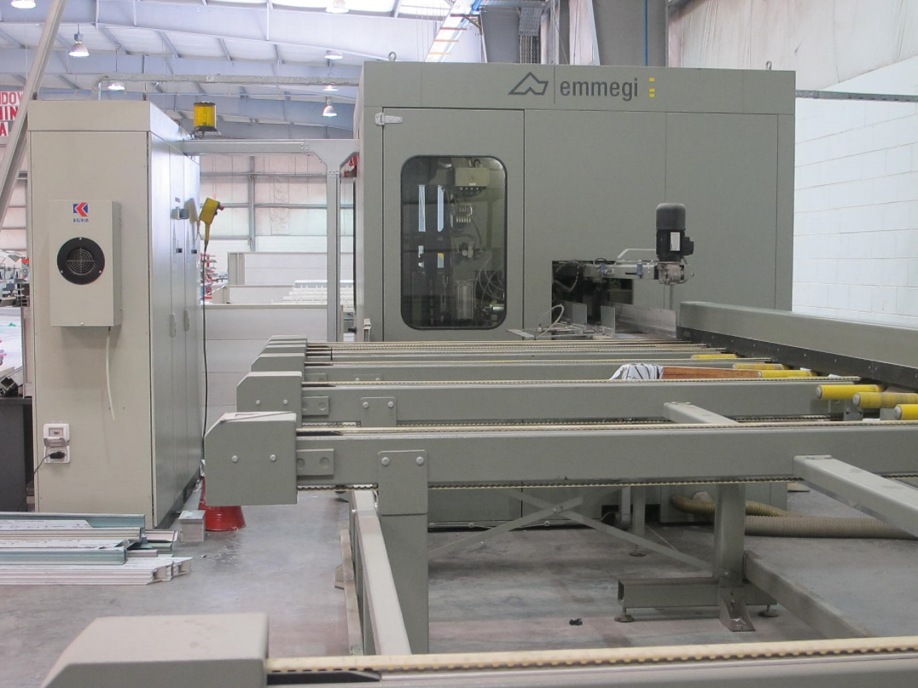
Facilities
DOOR & WINDOW MACHINING AREA

Slide 10
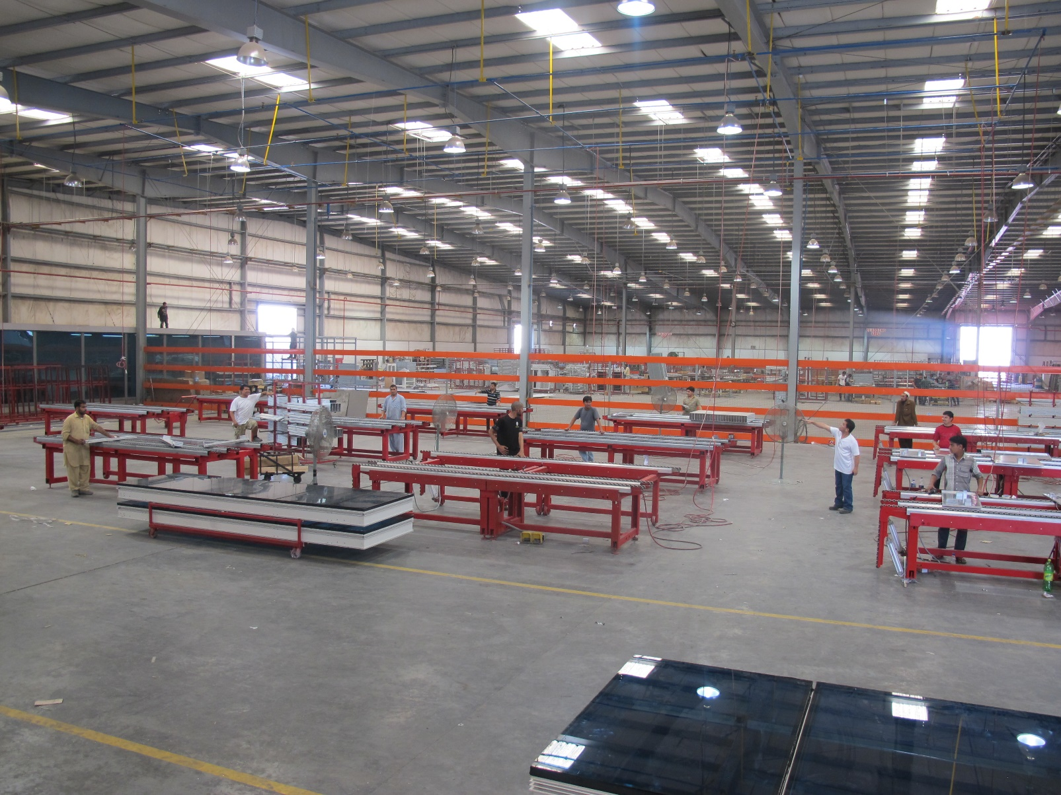
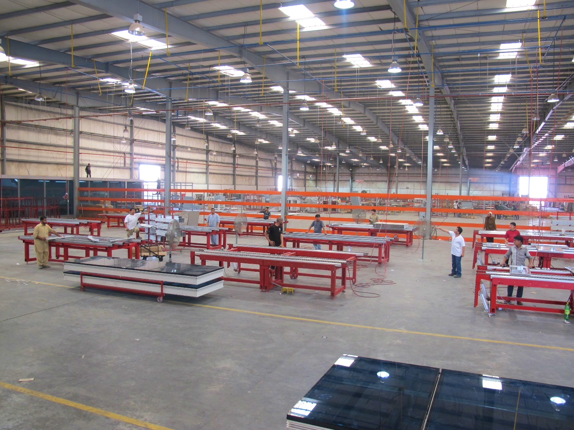
Facilities
UNITIZED CURTAIN WALL ASSEMBLY AREA

Slide 11
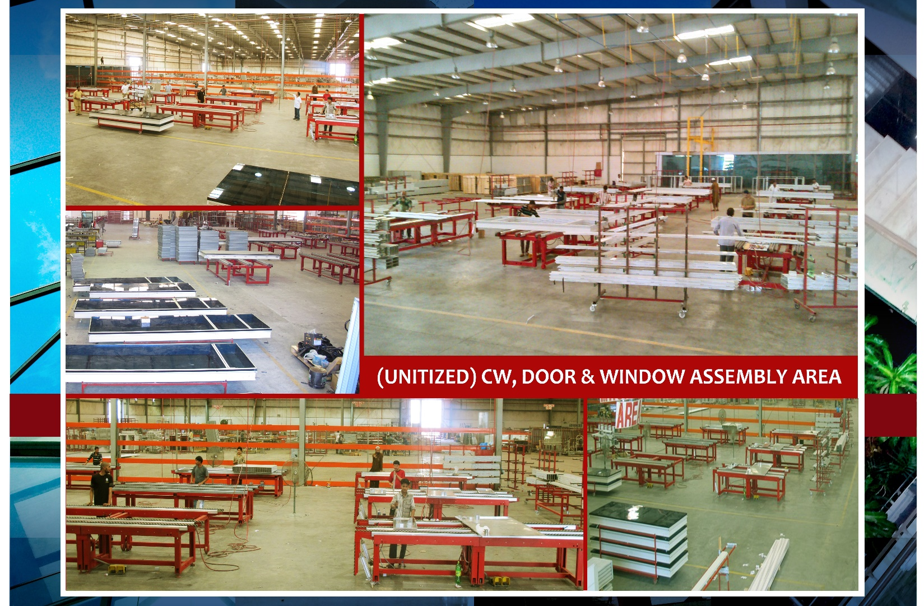
Facilities

Slide 12
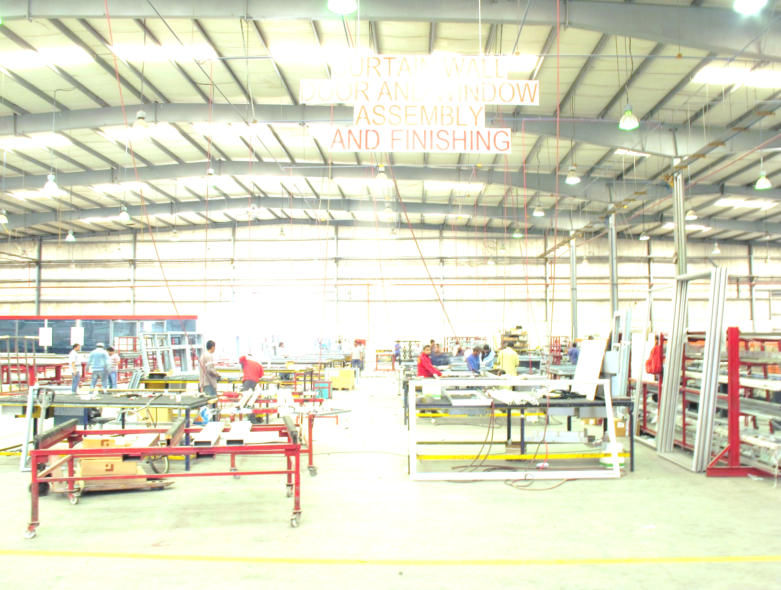
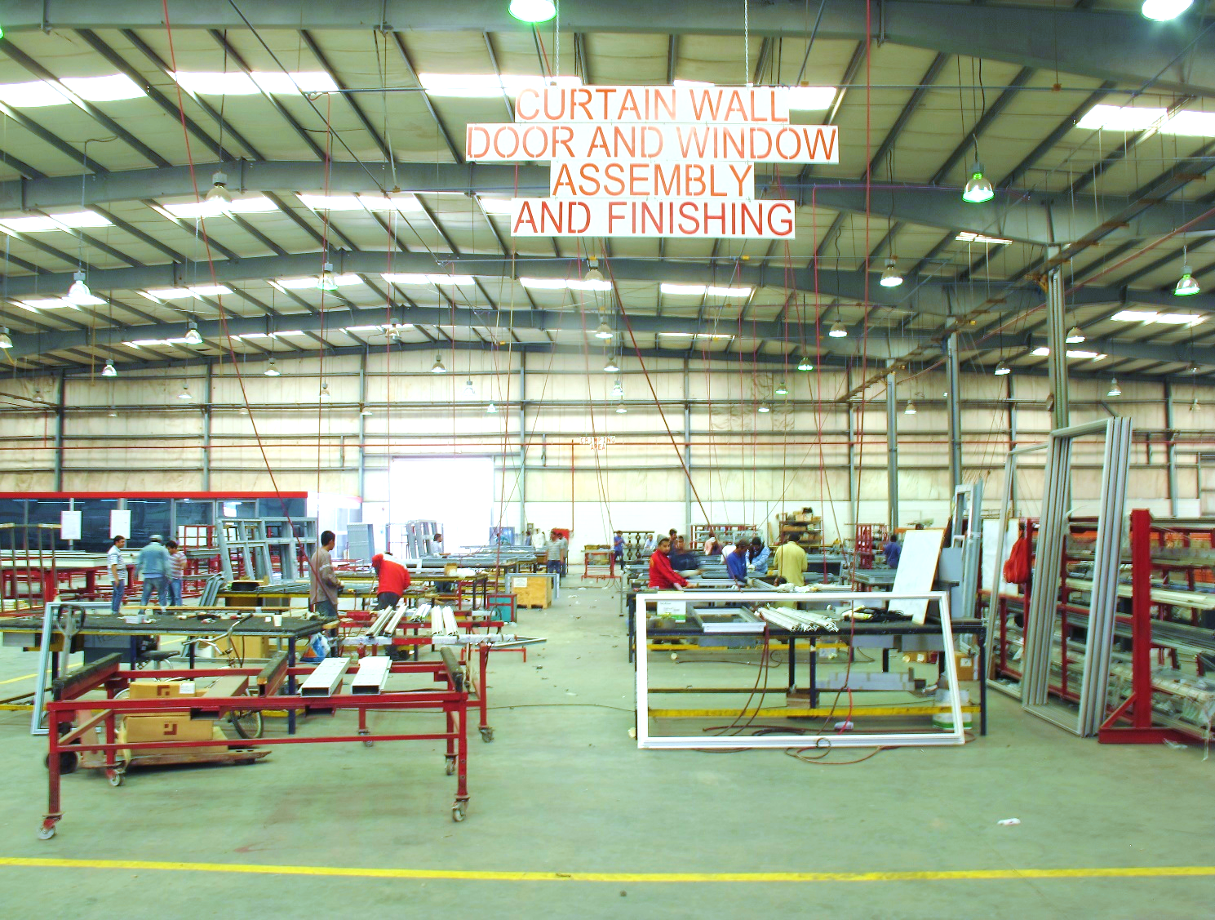
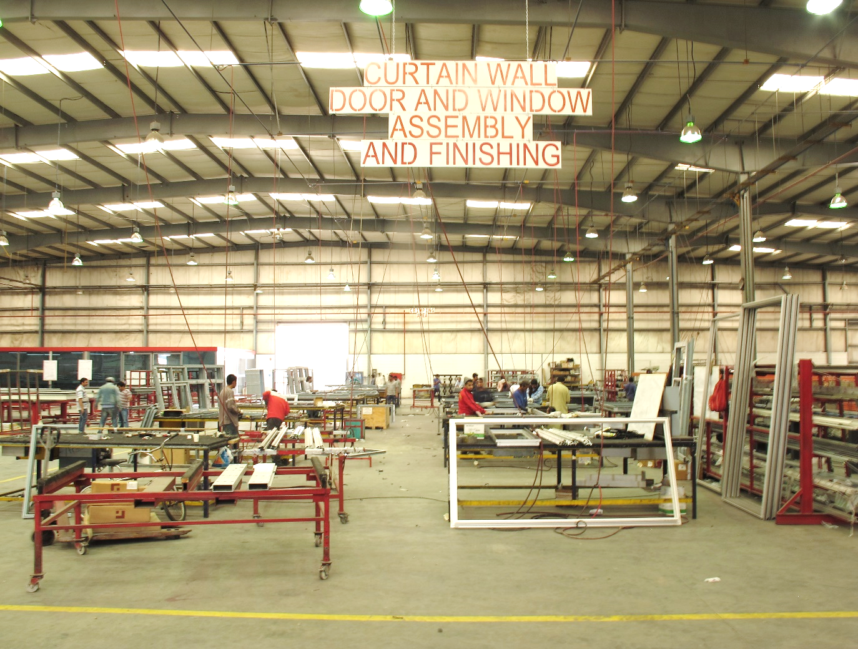
Facilities
CW, DOOR & WINDOW ASSEMBLY & FINISHING AREA

Slide 13
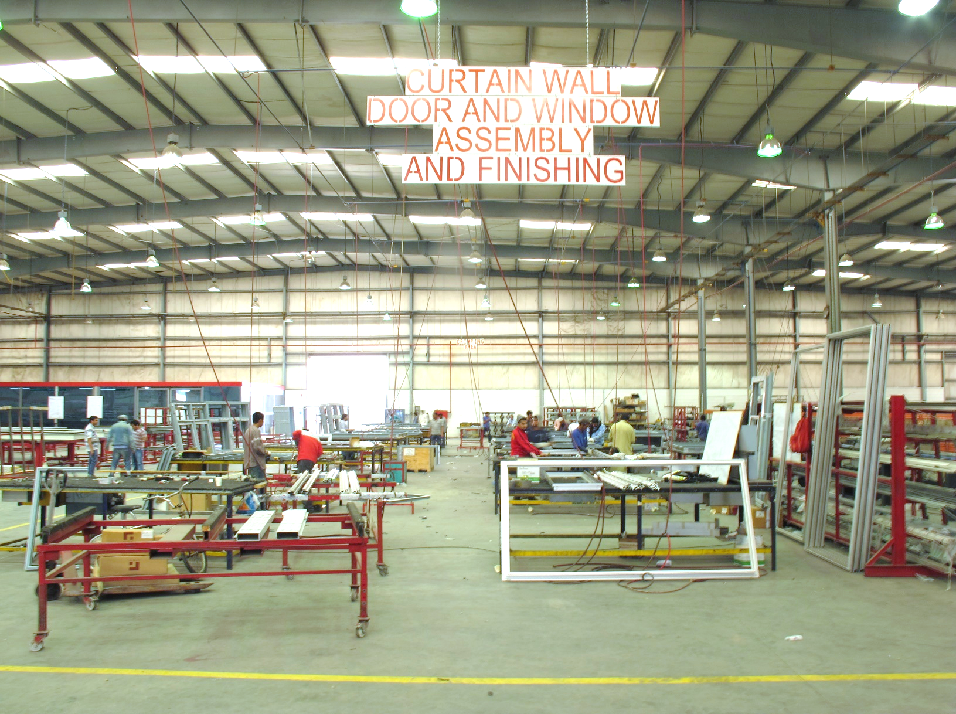
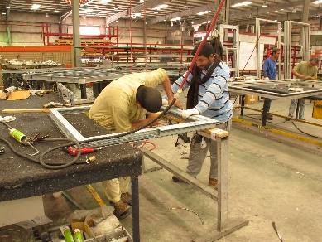
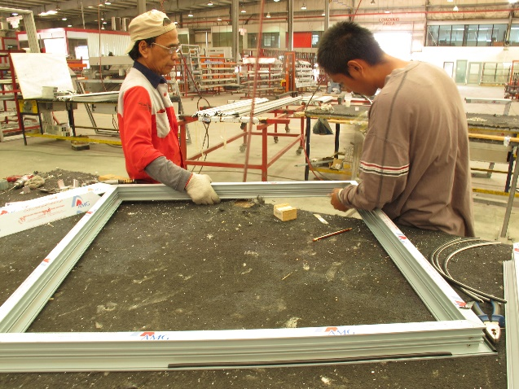
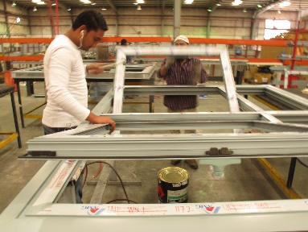
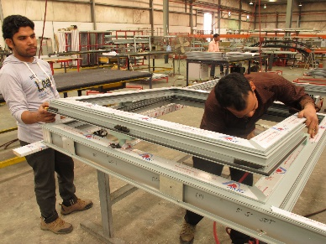
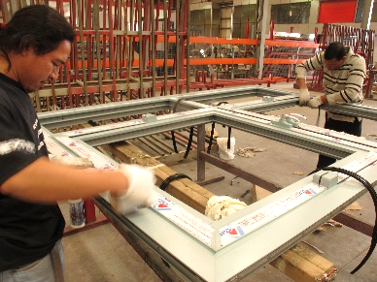
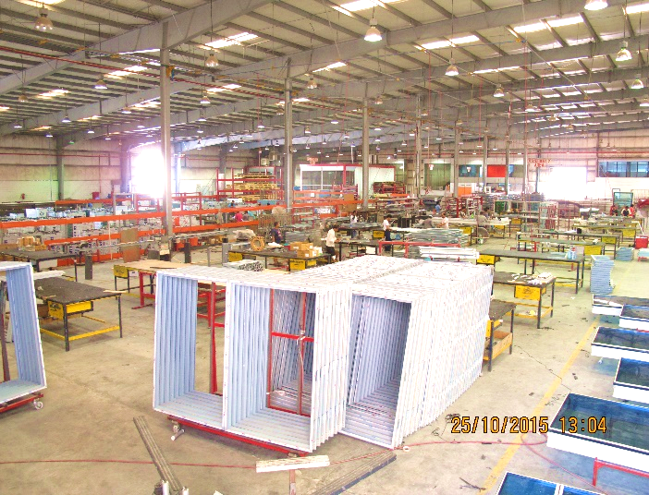
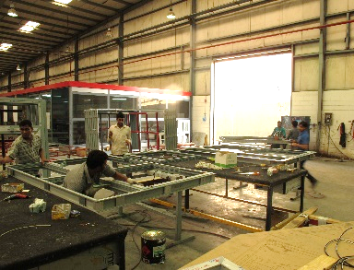
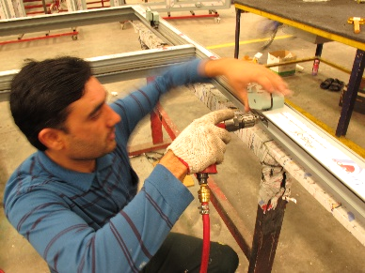
Facilities
CW, DOOR & WINDOW ASSEMBLY & FINISHING AREA

Slide 14
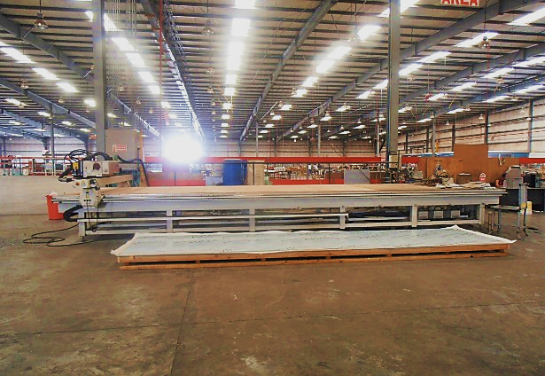
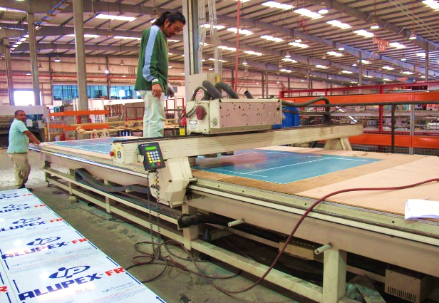
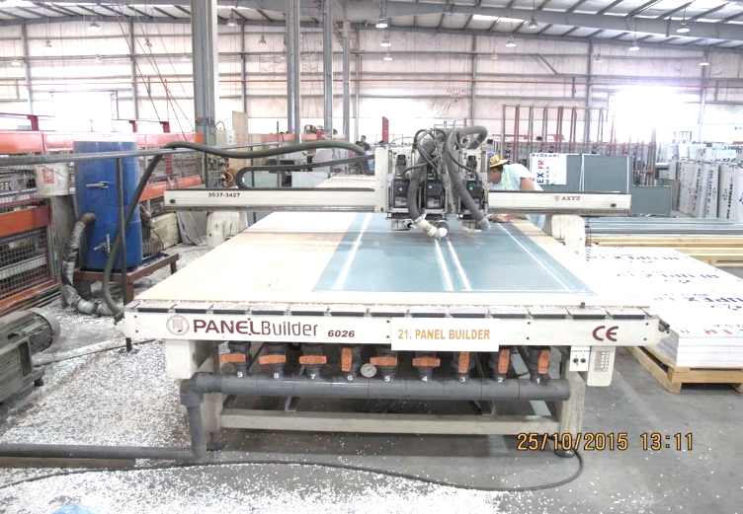
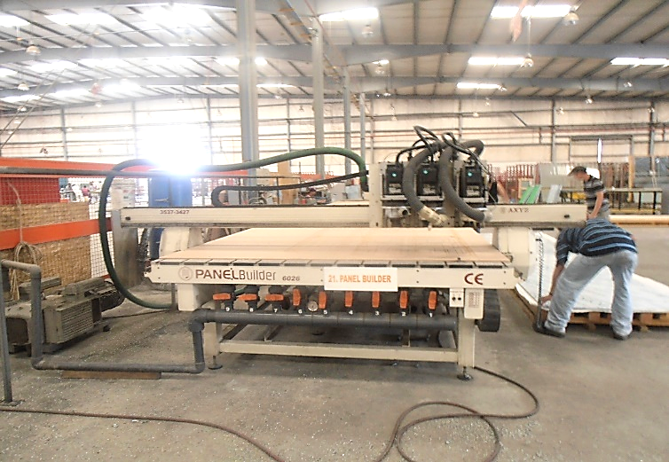
Facilities
ACP - CLADDING AREA

Slide 15
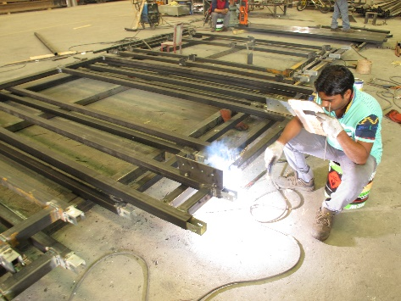
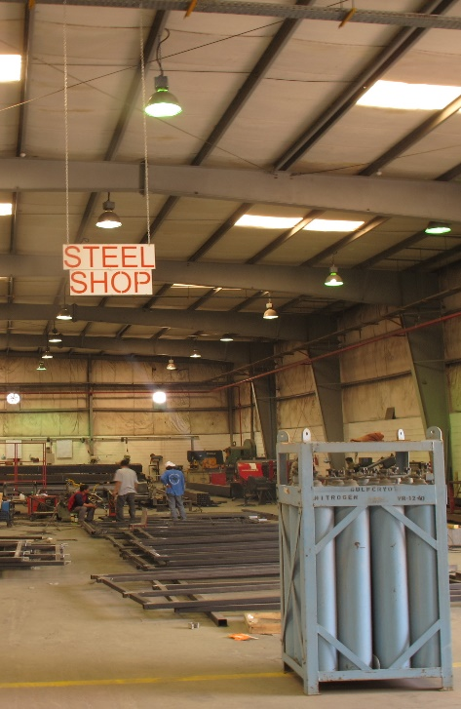
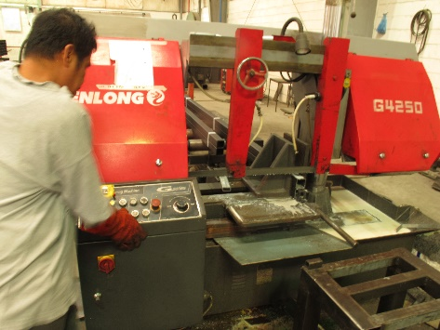
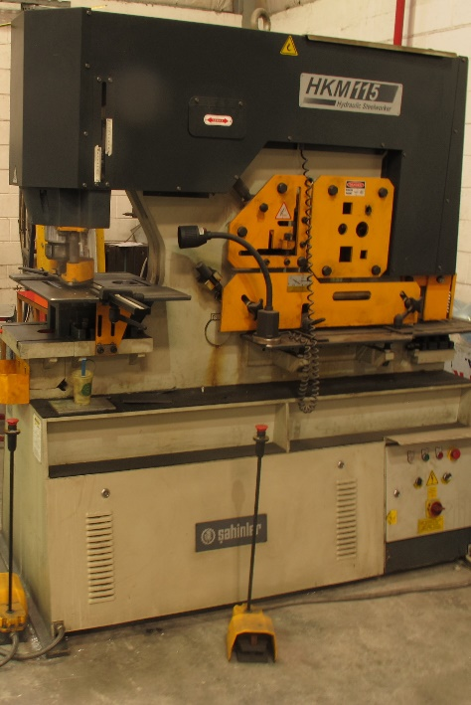
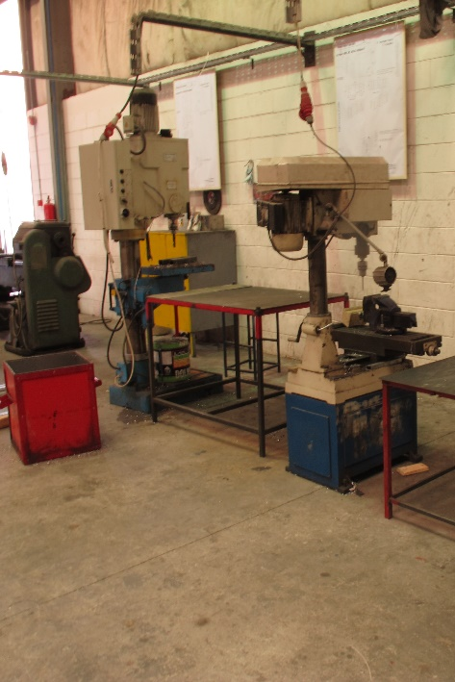
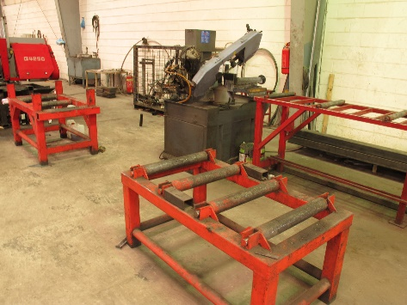
Facilities
STEEL WORKSHOP

Slide 16
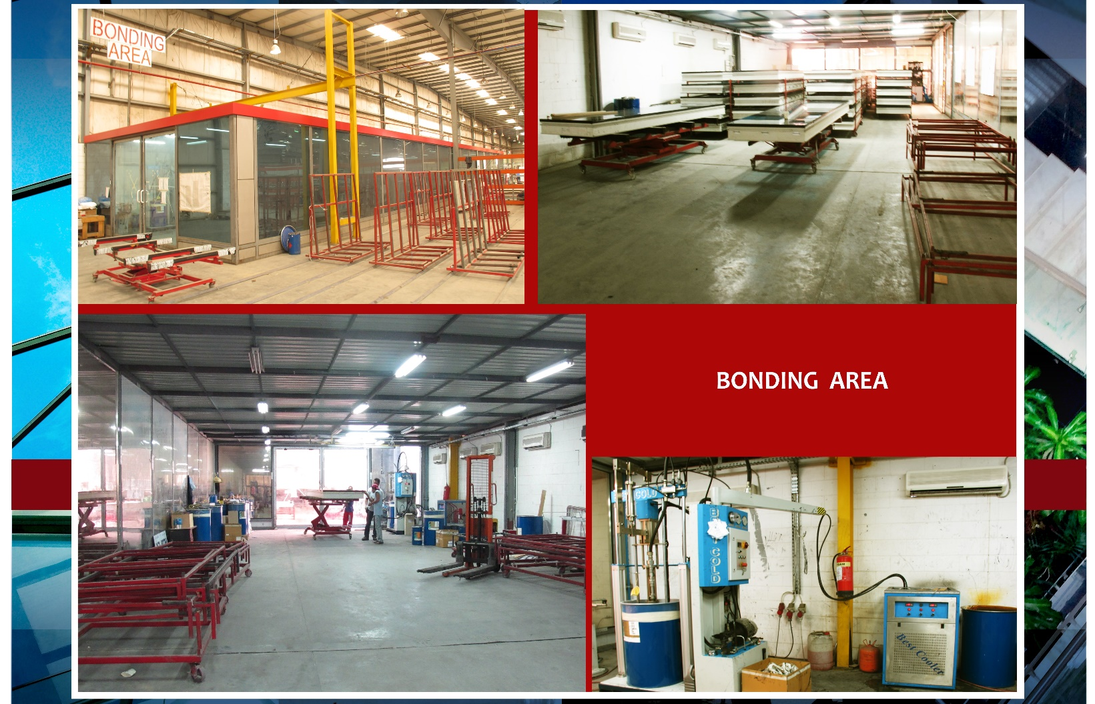
Facilities

Slide 17
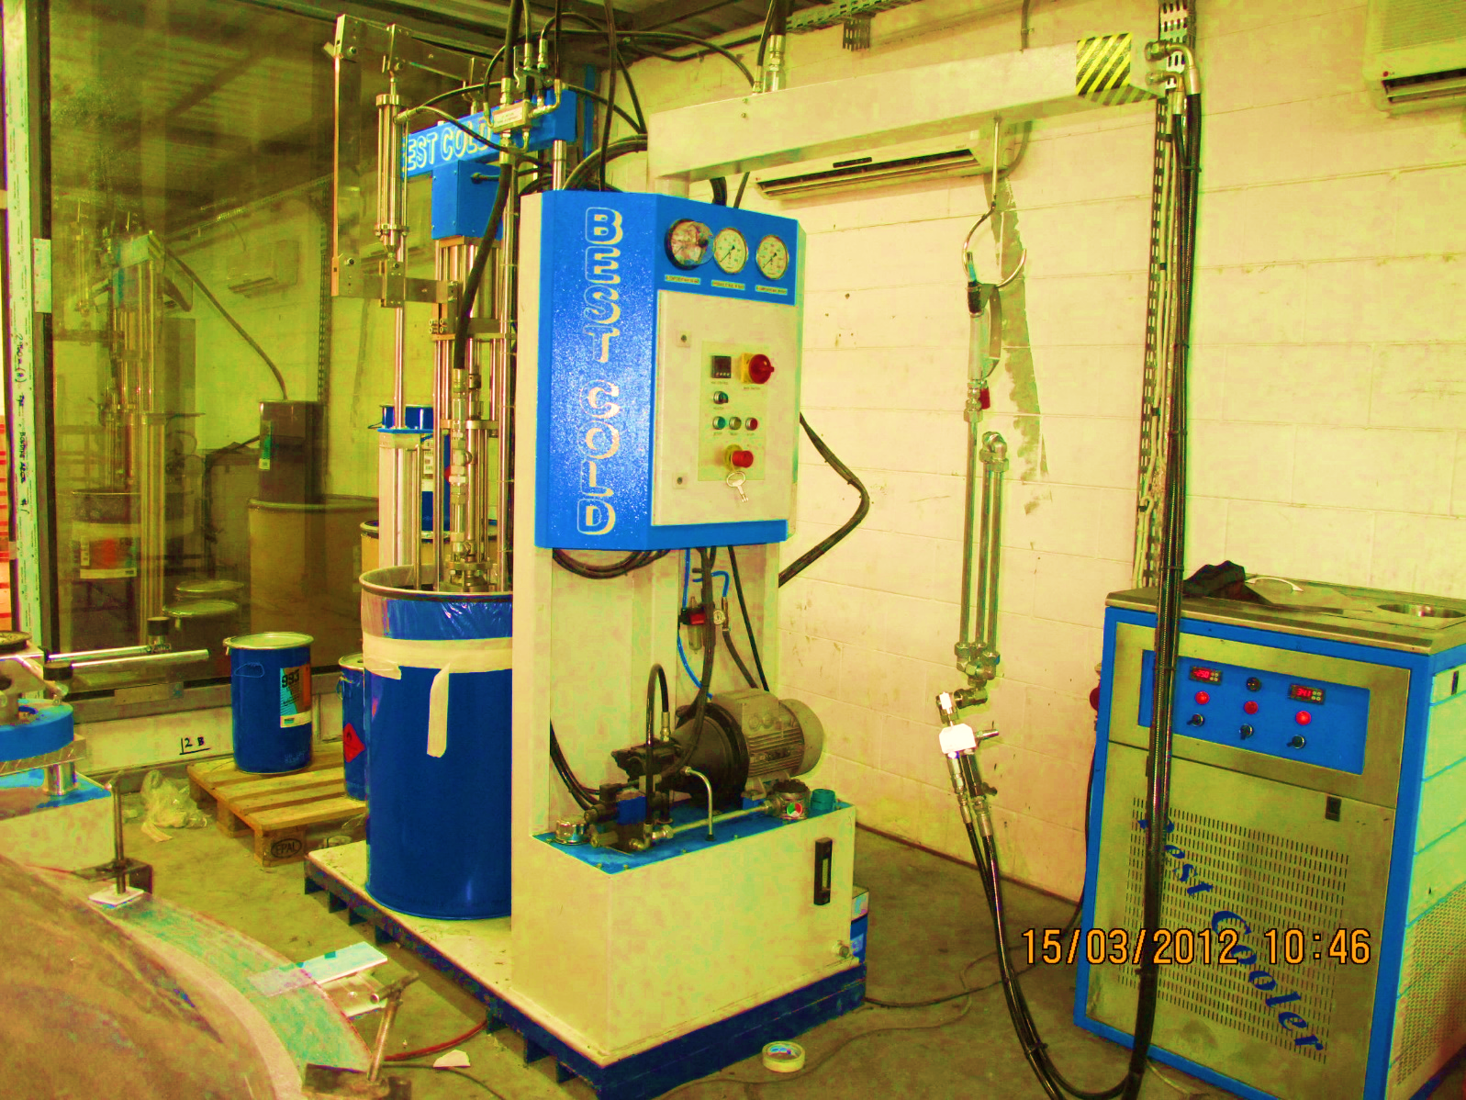
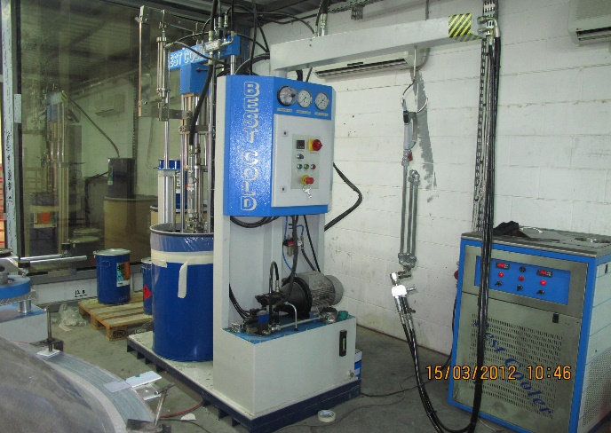
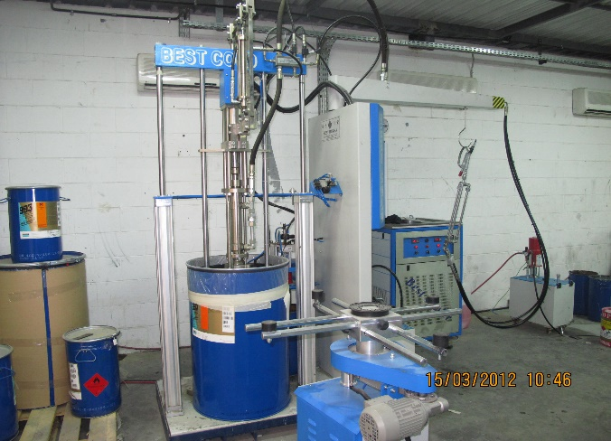
Facilities
BONDING AREA

Slide 18
Facilities

Slide 19
Facilities

Slide 20
Facilities

Slide 21
Facilities

Slide 22
WAREHOUSE AREA

Slide 23
AMG MAIN OFFICE

Slide 24
Major Equipment

Slide 25
Major Equipment
WATER JET MACHINE - (TEXA-00077457)

Slide 26
Major Equipment
LASER MACHINE – (ERMAK 18879-n8v654 )

Slide 27
Major Equipment
ALUMINUM CLADDING PANEL BUILDER – (AXYZ)

Slide 28
Major Equipment
CNC MACHINE (CUTTING) – (EMMEGI)

Slide 29
Major Equipment

Slide 30
Major Equipment

Slide 31
Major Equipment

Slide 32
Projects

Slide 33
Projects

Slide 34
Projects

Slide 35
Projects

Slide 36
Projects

Slide 37
Projects

Slide 38
Projects

Slide 39
Projects

Slide 40
Projects

Slide 41
Projects

Slide 42
Projects

Slide 43
Projects

Slide 44
Projects

Slide 45
Projects

Slide 46
Projects

Slide 47
Projects

Slide 48
Projects

Slide 49
Projects

Slide 50
Projects

Slide 51
Projects

Slide 52
Projects

Slide 53
Projects

Slide 54
Projects

Slide 55
Ongoing Projects
SFMC (MOI) PROJECT - Riyadh

Slide 56
Ongoing Projects
SAHAYEB 3 DATA CENTERS (Dammam)

Slide 57
Ongoing Projects
EDGNEX (KHAZZAN) DATA CENTER (SPARK - Dammam)

Slide 58
PRODUCT SPECIFICATIONS

Slide 59
ADVANCED MANUFACTURING FOR METAL & GLASS CO.
Company’s standard profiles are professionally designed and tested system. Having a range of fully integrated series of profiles, allowing manufacture of individual or composite units to suit a particular design option or variable to suit a multiplicity of client exacting requirements. The system conforms to most recognized European and International Standards from all aspect of design and fabricate, finishes of painting and/or anodizing, workshop practices, glazing and hardware. Skilled and trained installation teams are employed for improved operations.
The system has many unique and ingenious design features, it permits a variable glazing thickness of 4 mm to 24 mm glass or panels or any other type of in-fill construction using the bead clipping principle. Wall thickness of profile designed to suit particular application. Aluminum framed insect screens (single or double), quality system hardware: hinges, handles, locks, flush bolt and many other hardware such as panic devices and door closers (surface and floor mounted) are all available to suit specific design.
Corner joints are individually designed and are constructed by welding; screw fixings within profile screw ports or generally mechanically jointed using cast or extruded aluminum cleats secured by mechanical jointed using cast or extruded sealed in accordance with BS4873:1972. All doors and windows are glazed, fully weather-stripped and sealed against all elements with EPDM or equivalent gaskets. Aluminum insect screens where required are retained in aluminum frames using the rolled in gasket or clip method for fixing into main frame after installation. Windows are designed to allow water drainage to the exterior.
Quality finishes to surfaces of aluminum profiles, panels, hardware and accessories, etc. may be in either anodizing or polyester painting. Many colors are available to suit client individual requirements.
Unless otherwise required/specified all exposed profiles are anodized to Grade AA20 or 20 microns minimum average thickness in accordance with BS 1615:1972.

Slide 60
PRODUCT SPECIFICATIONS
1.) Conforming to following British and International Standards:
BS DIN ASTM
Manufactured from extruded BS 1474 17615P3
Aluminum alloys generally.
Anodizing to BS3987 17611
Glass-Generally to comply with requirements of BS 952 n/a 1036
Glazing in accordance with BS6262 n/a Uniform Building
Regulations
Sealant-single part gun grade polysulphide based BS5215 n/a C920
Wind Loading BS CO-3 n/a E330
Chapter V Part2
Construction-in accordance with BS 4873:1972
Section 5.2.6
Weather-strip – EPDM International Standards 1503934 – 1978(E) 7863 C864
Design Criteria General
BS 4313: 1968
DD 4 : 1971
BS 5386: Part1 : 1976
Part2: 1980
Part3: 1974

Slide 61
2.) Performance
Working with the above standards codes and drawings should not change the dimension or shape of the window and their components caused by presence or absence of water or variations in moisture conditions or temperature changes including the effect or differential temperature difference between and within the various components or deformation due to sporadic pressure of suction from the wind or by reason of their being used for their purpose or for any other cause within normal limits shall not effect the appearance, use, or color or performance specified.
All surface finish shall be uniform in texture, color and appearance within the limits of the approved samples and without irregularities or distortions. Rivets and screws etc., which are not intended to be visible shall be treated so that there is no discontinuity of the finished surface.
3.) Construction
The design and method of construction shall be consistent with good and proven practice. Windows shall generally comply with BS 4873: 1972 in respect to materials, work, sizes, manufacturing tolerance, glazing securities safety and performance. The outer frames and leaves are crimped cleated and sealed at each corner. All in accordance with BS 4873: 1972 Section 5.2.6. All units shall be fabricated to agreed tolerances. No metals likely to cause galvanic or other corrosion shall be placed in contact with the aluminum. Any other dissimilar materials shall be treated to avoid such action between metals.
4.) Delivery and Protection
AA. Aluminum window frame, components and accessories will be, suitable protected with low tac tape or other means from the time of leaving our premises to the installation on the building, suitable storage to be provided for all materials.
All window units, assemblies or elements are to be prepared and packaged for transport to the site. All corners, edges and finished surfaces are to be adequately protected to avoid damages.
5.) Sealant
One part polysulphide based gun grade in accordance with BS 5215, supported by suitable polyethylene backing core applied in accordance with manufacturer’s recommendations.
6.) Weather –stripping
All opening sections are weather-stripping with EPDM gaskets to International Standards
1503934 – 1978 (E)
DIN 7715 cat. E
BS 3734 And silicone brush.

Slide 62
7.) Materials
All aluminum frames and shutter profiles extruded from the following:
A1 Mg Si 0.5 F22 - F25
A1 Mg Si 1.0 F28 ) -- World Designation
A1 Mg Si 1.0 F32 – F36)
All in accordance with BS 1474
Anodizing to BS 3987:1974 (Anodic Oxide Coating on wrought aluminum for external architectural applications.)
The finished anodized surface shall be free from “Banding, Streaking and Smut”. Color to be controlled within approved top and bottom limits agreed.
Fasteners shall be tempered aluminum, stainless steel or other metallic or non-metallic materials non-corrosive and compatible with the aluminum members.
8.) Hardware / Accessories
Side Hung Windows
Operating handles will be manufactured from one or more of the following materials with non-corrosive pins and springs etc.
aa. Extruded Aluminum
bb. Die Cast Aluminum
cc. Die Cast Mazak
Each shutter will be mounted on one set of aluminum extruded hinge with stainless steels pin and nylon bushes.
Bottom Hung Windows
One spring loaded catch manufactured from one or more of the following materials with non-corrosive pins and springs etc.
aa. Extruded Aluminum
bb. Die Cast Aluminum
cc. Die Cast Mazak
Each leaf will be fitted with a set of hinges and a set of arms.
Sliding Windows
Each sliding leaf shall receive the following hardware:
aa. 3 Rollers / Leaf
bb. One (1) side Handle / Lock
The frame shall accommodate handle sticker plate and dust plugs.

Slide 63
Side Swing Doors
Single Swing Doors shall have the following fittings;
aa. Two (2) nos. Hinges
bb. One (1) no. Lock
cc. One pair of Lever Handle
dd. One (1) pair of Flush Extension Bolt
ee. One (1) Door Closer (optional)
All the steel pins and springs etc. used in above mentioned accessories shall be in stainless steel.
Double Swing Door
Double swing doors incorporate the following accessories;
aa. One (1) no. Floor Closer per leaf
bb. One (1) no. Dead Lock per door
cc. One (1) pair of Push/Pull Bar or Plate
dd. One (1) pair of Extension Flush Bolt
9.) Workmanship
The standard of workmanship, comprising design, fabrication and delivery shall be the best possible standard. Cutting shall be straight and free from burrs and joints without gaps or imperfections except as designed. The glass is secured in a gasket manufactured from EPDM and is installed in the shutter frame either by the bead principle or wrap around dependent on type of windows. All in accordance with BS 4873: 1972 and BS 6262 : 1982 glazing for buildings.
10.) Drawings
Drawings shall be submitted in accordance with the following; the elevation of the unit, full size cross section, thickness, standard dimensions, the method of installing, anchorage, size of anchors and gap between them and method of weather-stripping.

Slide 64
AMG - System Drawings

Slide 65
Sliding System

Slide 66
Sliding System

Slide 67
Sliding System

Slide 68
Sliding System

Slide 69
Sliding System

Slide 70
Sliding System

Slide 71
Sliding System

Slide 72
Sliding System

Slide 73
Sliding System

Slide 74
Window System

Slide 75
Window System

Slide 76
Window System

Slide 77
Window System

Slide 78
Window System

Slide 79
Window System

Slide 80
Window System

Slide 81
Door System

Slide 82
Door System

Slide 83
Door System

Slide 84
Door System

Slide 85
Curtain Wall System

Slide 86
Curtain Wall System

Slide 87
Curtain Wall System

Slide 88
Curtain Wall System

Slide 89
CUSTOM MADE DESIGNS

Slide 90
CUSTOM MADE DESIGNS

Slide 91
Certificates

Slide 92
Certificates

Slide 93
Certificates

Slide 94
Certificates

Slide 95
Certificates

Slide 96
www.amg-metal.com

